Slide 1

Artificial Intelligence and Machine Learning
Logistic Regression

Slide 2
Lecture 2: Outline
Linear Regression (Review)
Logistic Regression (Classification)
Optimization

Slide 3
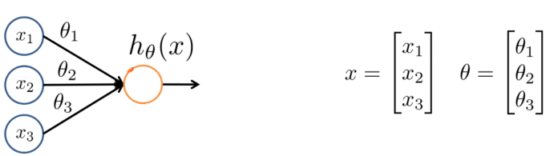
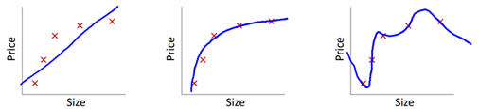
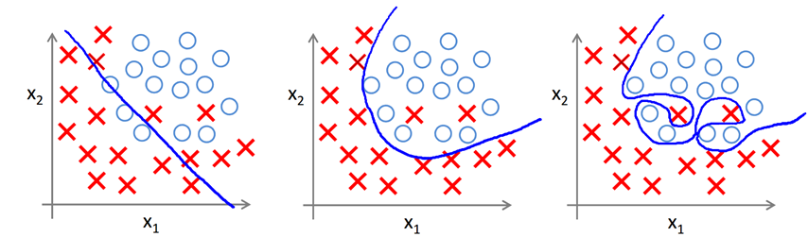
Regression VS classification
Regression (linear and polynomial): for prediction
Classification:

Slide 4
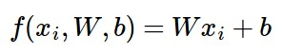
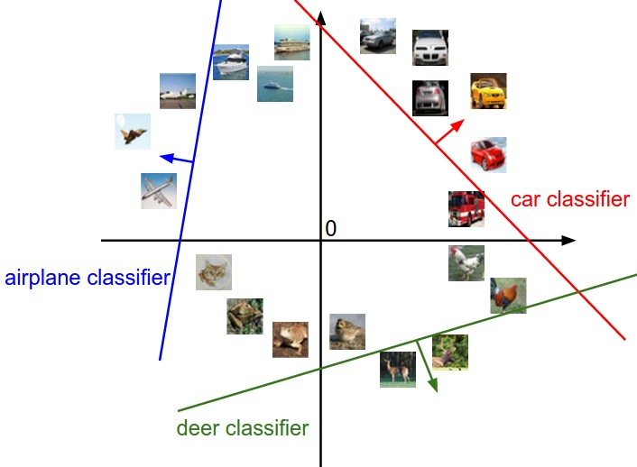

Interpreting a Linear Classifier
[32x32x3]
array of numbers 0...1
(3072 numbers total)

Slide 5
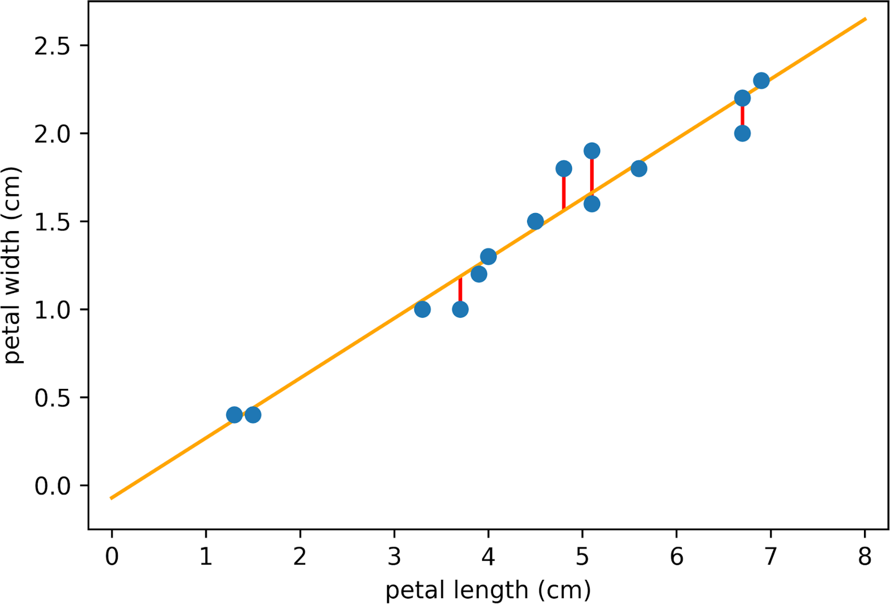
Recap
Design your model
Input scalar linear model (line fitting)
Fitting polynomials (synthetically designing features from a one-dimensional input)
Design your loss function
We used mean squared error loss throughout
Finding optimal parameter fitting
Closed form solution to the linear least squares?
Why is it linear least squares?
Solution is closed form

Slide 6
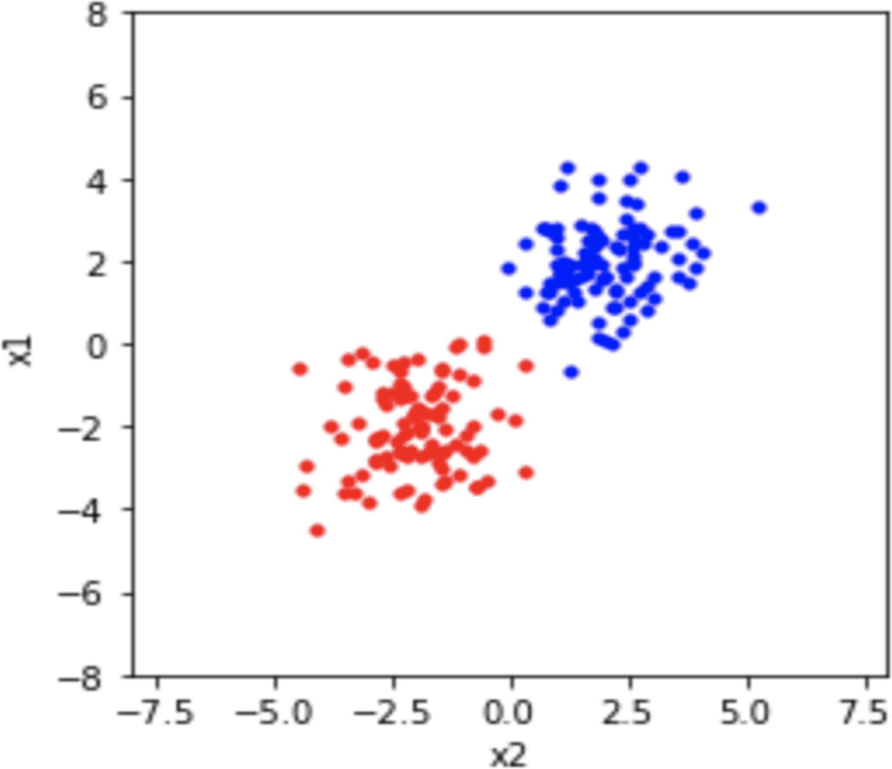

Logistic Regression

Slide 7
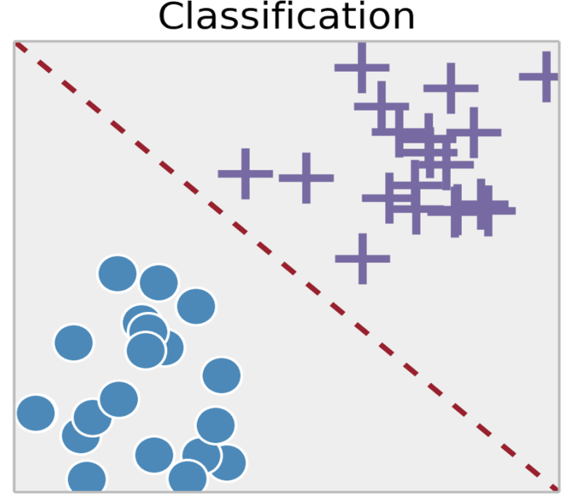
Logistic Regression Examples
Regular vs Fraudulent transaction
Spam vs Non-spam emails
Benign vs Malignant tumors
Rising vs Falling stocks

Slide 8
Logistic Regression Examples
Despite the name, logistic regression is a
classification algorithm
Misnomer!
Logistic Regression is a linear model with a “special function” that helps us use this linear model for classification

Slide 9
Linear Model in Disguise

Slide 10
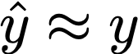
Linear Model in Disguise
Recall that the output/label y is binary
How to map the predictions to binary?

Slide 11
Challenge:

Slide 12
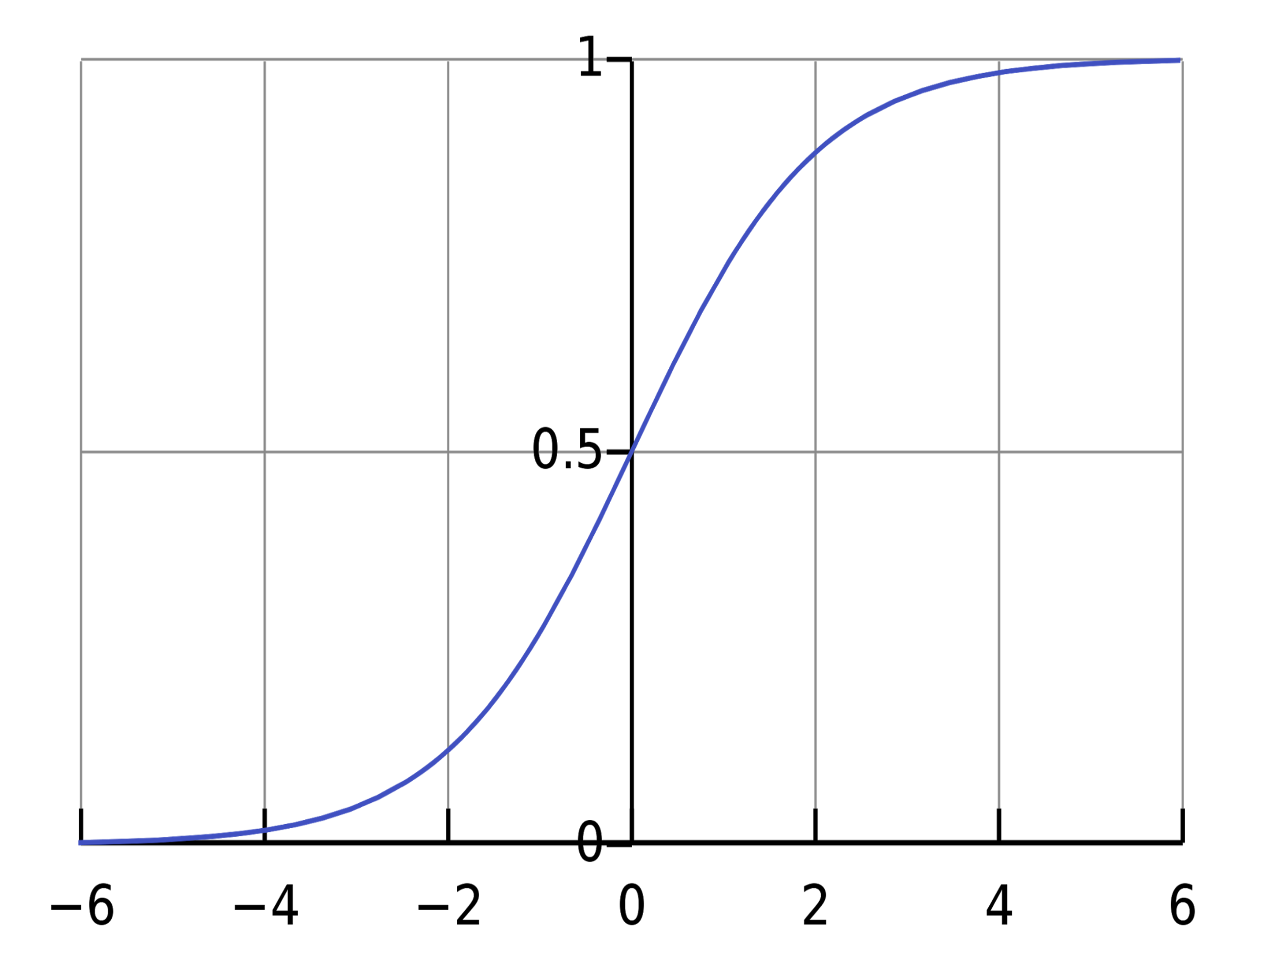
Sigmoid Function
Widely used in classification
Notes:
\sigma(z) = \frac{1}{1+exp(-z)}
\lim_{z \to \infty} \sigma (z) =0

Slide 13
Cost Function
We want to minimize the discrepancy between our model hypothesis and the observed label.

Slide 14
What type of loss to use?

Slide 15
Binary Cross Entropy Loss
Notes:
J(\mathbf{w}) = \frac{1}{N}\sum_{i=1}^N \text{compare} (y_i, \sigma(\mathbf{w}^T \mathbf{x}_i))
J(\mathbf{w}) = -\frac{1}{N}\sum_{i=1}^N y_i \log(\sigma(\mathbf{w}^T \mathbf{x}_i)) + (1-y_i)\log(1-\sigma(\mathbf{w}^T \mathbf{x}_i))

Slide 16
Intuition of Cost Function
Cost Function
Hypothesis

Slide 17
How to find minima of a function (Review):
Notes:
\frac{d J(m)}{dm} = \frac{d}{dm}\sum_{i=1}^3 (i - mi)^2

Slide 18
How to find optimal Parameters?
Just like before, simply take
However, this does not have a nice closed solution Just like the MSE case

Slide 19
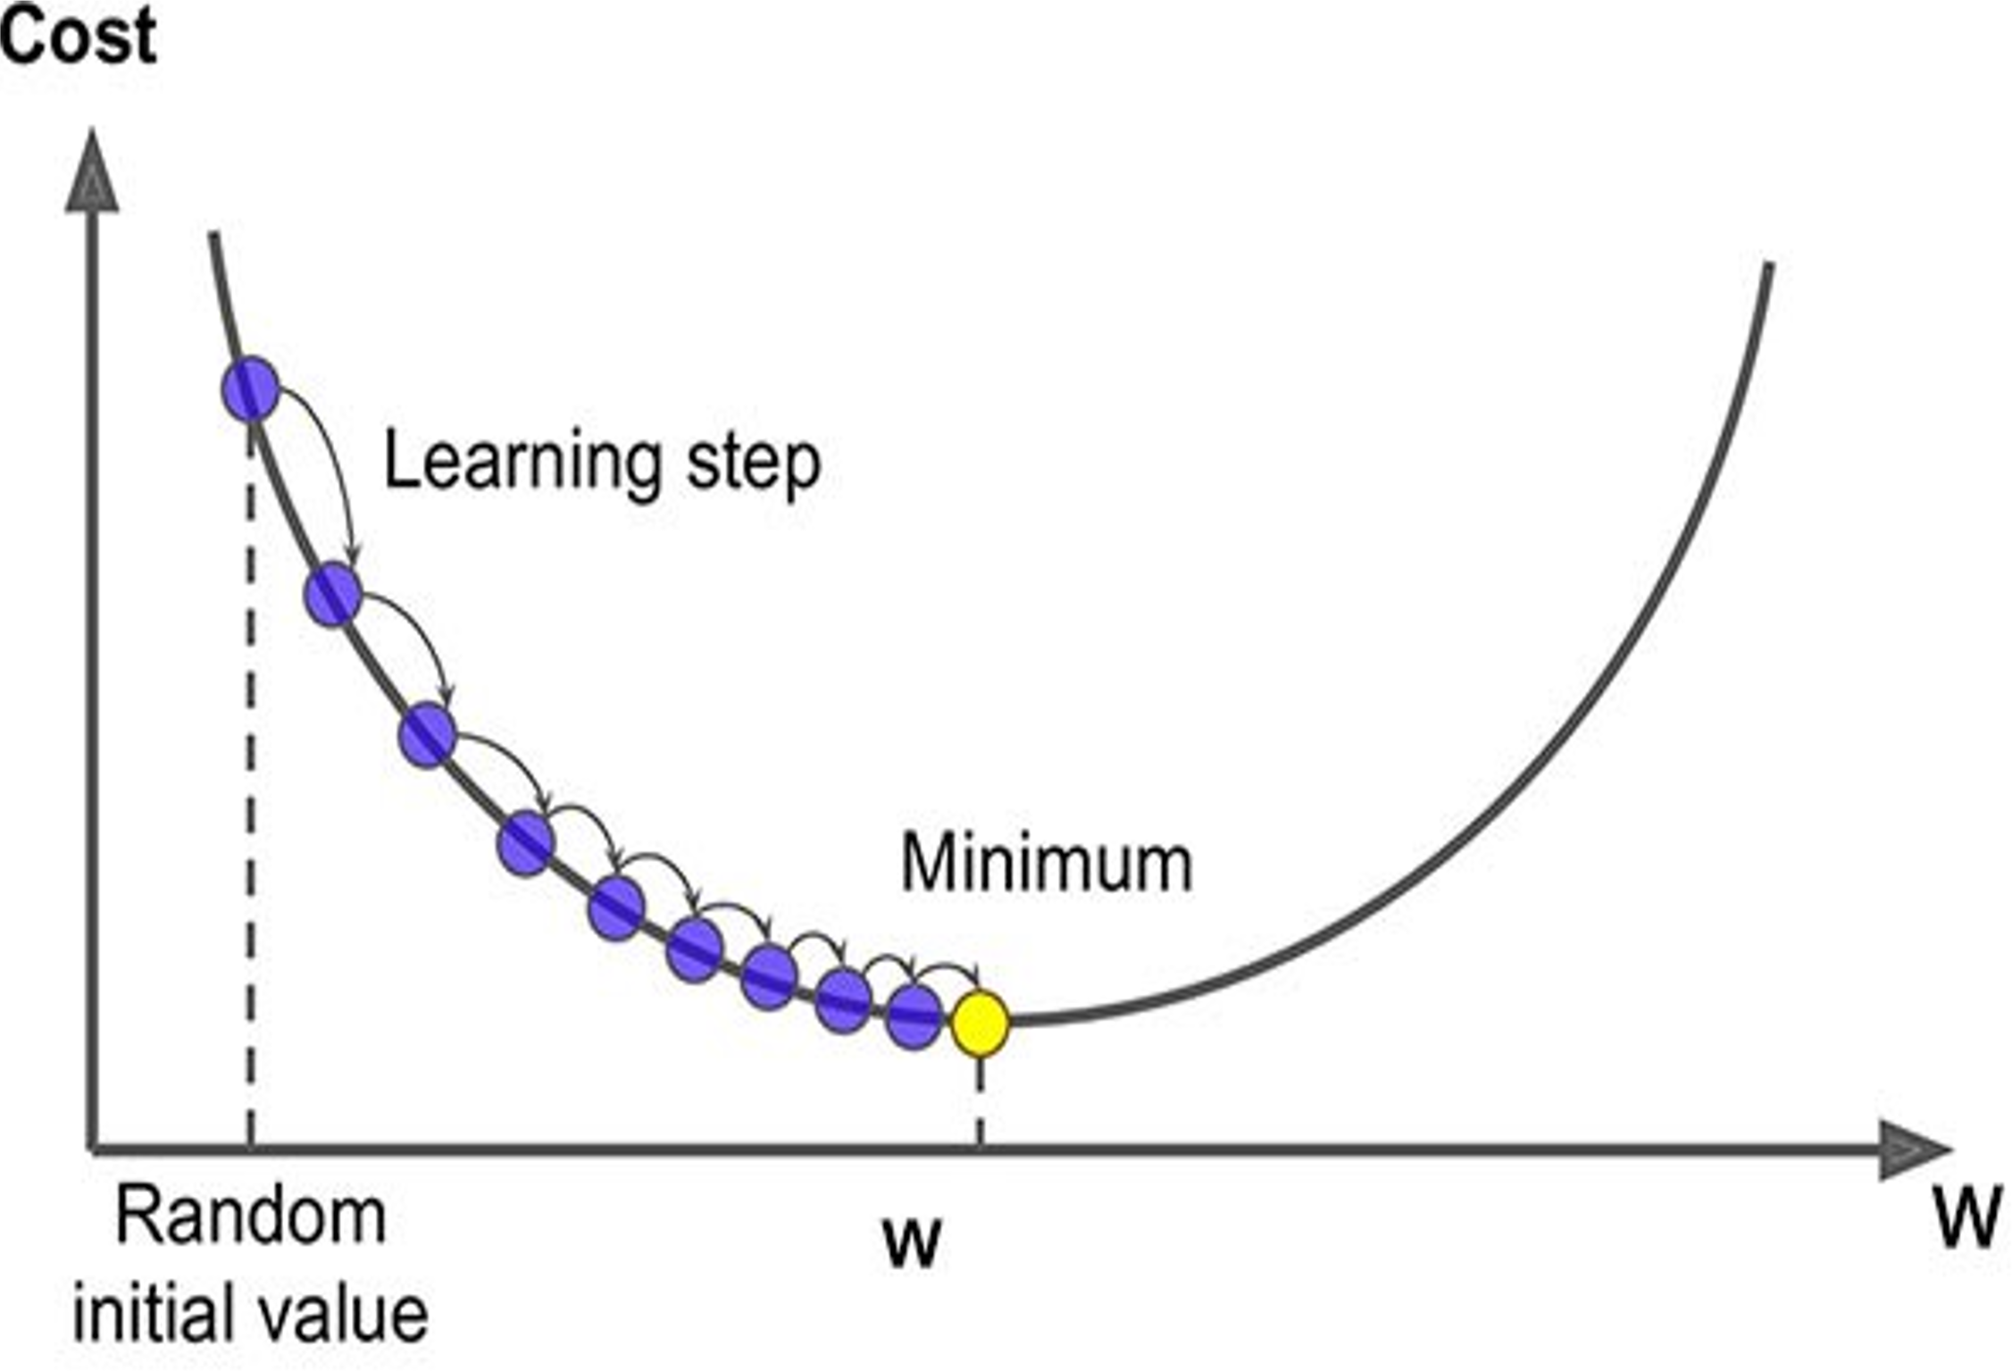
How to find optimal Parameters?
Just like before, simply take
However, this does not have a nice closed solution Just like the MSE case
Instead, do gradient descent!
Learning rate
Notes:
\mathbf{w}^{k+1} = \mathbf{w}^{k}- \eta\nabla_{\mathbf{w}}J(\mathbf{w}^k)

Slide 20
Logistic Regression
Learning rate
We have a linear model for prediction
For classification, we want to output a probability
We map the prediction to probabilities with a sigmoid function
We have a loss function (BCE) to compare models

Slide 21
Logistic Regression
Linear Regression | Logistic Regression
For Regression | For Classification
We predict the target value for any input value | We predict the probability that the input value belongs to the specific target
Target: Real Values | Target: Discrete values
Graph: Straight Line | Graph: S-curve

Slide 22
What do we do for many Classes
Sigmoid
Cross Entropy

Slide 23
A Slight Detour: A Look at Optimization Tools

Slide 24
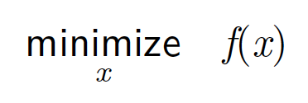
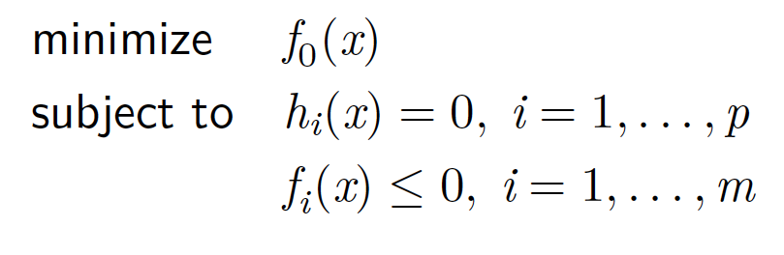
Optimization
Unconstrained Optimization
Constrained Optimization

Slide 25
Taylor Series approximation of function
Let’s have a look at the Taylor series approximation of function of single and multiple variables:
The Taylor Series is a mathematical concept used to approximate functions. Given a sufficiently differentiable function, its Taylor Series expansion allows us to express the function as an infinite sum of terms calculated from the values of its derivatives at a single point. This is particularly useful in various fields, including physics, engineering, and economics, for simplifying complex functions and in numerical methods.

Slide 26
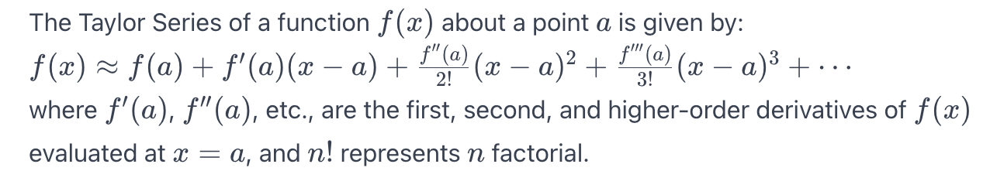
Taylor Series approximation of function
Let’s have a look at the Taylor series approximation of function of single and multiple variables:
Function Approximation: The Taylor Series approximates a function f(x) around a specific point a.
Infinite Series: The approximation is made using an infinite sum of terms derived from the derivatives of the function at that point.

Slide 27
Direction of maximum increase and decrease for a function
Gradient direction is the direction of maximum increase for a function
Negative gradient is the direction of maximum decrease for a function

Slide 28
Line Search Framework for Unconstrained Minimization
minimize f(x)
x
Solution Template
k = 0
choose a starting point, x⁰
while (not converged)
choose a search direction, p^{k}
choose a step size in the search direction, t x^{k+1} = x^{k} + t p^{k}
k = k + 1

Slide 29
Backtracking Line Search
Simple and eﬀective strategy for line search
Reduce t incrementally: t = β t
Termination condition: f (x^{k} + tp^{k}) ≤ f (x^{k}) + αt ∇f (x^{k})^{t}p^{k}
Curvature condition automatically satisﬁed
Algorithm parameters: α and β

Slide 30
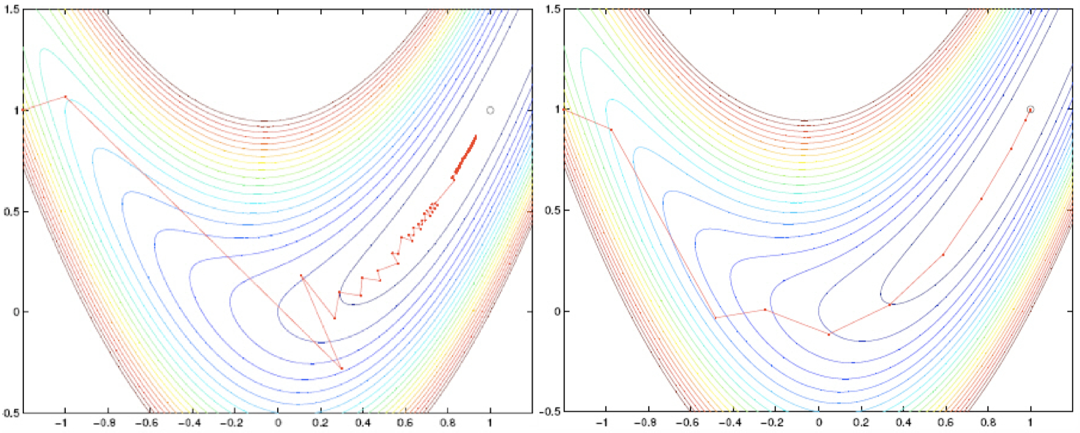
Sample Search Paths

Slide 31
Steepest Descent with Backtracking in Matlab
1 function t = backtrackLineSearch(f, gk, pk, xk)
2 a = 0.1; b = 0.8; % α and β parameters
3 t = 1;
4 while ( f(xk+t*pk) > f(xk) + a*t*gk'*pk )
5 t = b * t;
6 end
1 function [x, hist] = steepestDescentBT(f, grad, x0)
2 x = x0; hist = x0; tol = 1e-5;
3 while (norm(grad(x)) > tol)
4 p = -grad(x);
5 t = backtrackLineSearch(f, grad(x), p, x);
6 x = x + t * p;
7 hist = [hist x];
8 end

Slide 32
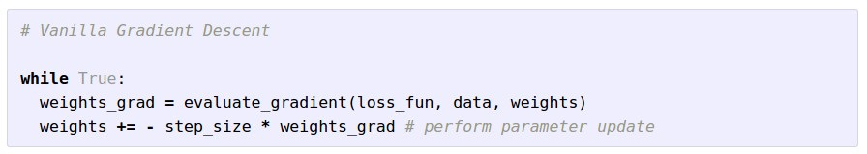
Gradient Descent

Slide 33
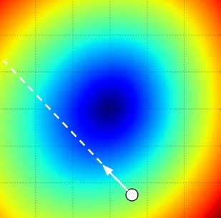
W_2
original W
W_1
negative gradient direction

Slide 34
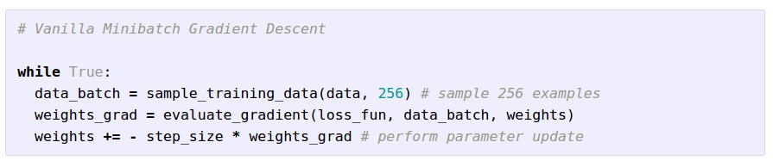
Mini-batch Gradient Descent
only use a small portion of the training set to compute the gradient.
Common mini-batch sizes are 32/64/128 examples
e.g. Krizhevsky ILSVRC ConvNet used 256 examples

Slide 35
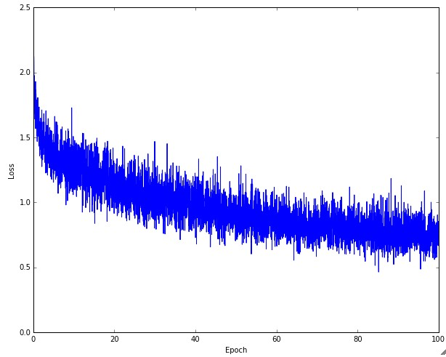
Example of optimization progress while training a neural network.
(Loss over mini-batches goes down over time.)

Slide 36

The effects of step size (or “learning rate”)

Slide 37
Mini-batch Gradient Descent
only use a small portion of the training set to compute the gradient.
we will look at more fancy update formulas
(momentum, Adagrad, RMSProp, Adam, …)
Common mini-batch sizes are 32/64/128 examples
e.g. Krizhevsky ILSVRC ConvNet used 256 examples

Slide 38
Minibatch updates
W_2
True negative gradient direction
W_1
original W
Slide based on CS294-129 by John Canny

Slide 39
Stochastic Gradient
W_2
noisy gradient from minibatch
W_1
original W
Slide based on CS294-129 by John Canny

Slide 40
Stochastic Gradient Descent
W_2
True gradients in blue minibatch gradients in red
W_1
original W
Gradients are noisy but still make good progress on average
Slide based on CS294-129 by John Canny

Slide 41
You might be wondering…
W_2
Standard gradient
Can we compute this?
W_1
Slide based on CS294-129 by John Canny

Slide 42
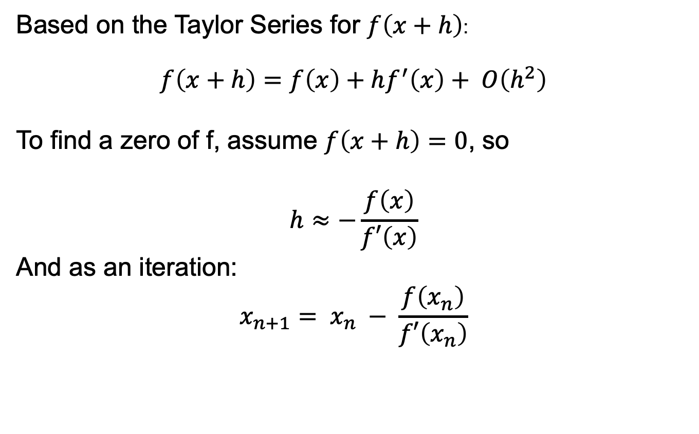
Newton’s method for zeros of a function
Based on the Taylor Series for $f\left(x+h\right)$:
$$f\left(x+h\right)=f\left(x\right)+hf^{′}\left(x\right)+ O\left(h^{2}\right)$$
To find a zero of f, assume $f\left(x+h\right)=0$, so
$$h≈−\frac{f\left(x\right)}{f′\left(x\right)}$$
And as an iteration:
$$x_{n+1}= x_{n} − \frac{f\left(x_{n}\right)}{f′\left(x_{n}\right)}$$
Slide based on CS294-129 by John Canny

Slide 43
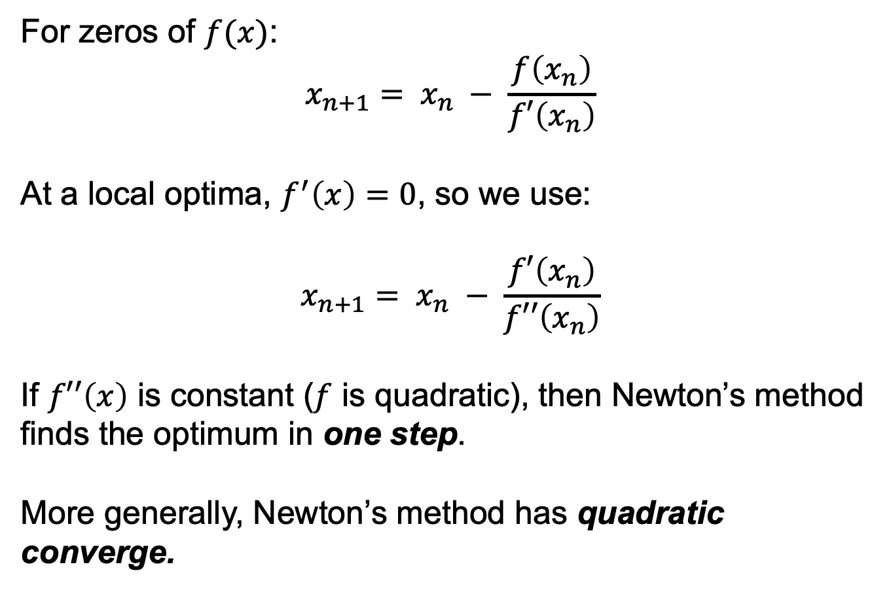
Newton’s method for optima
For zeros of $f(x)$:
$$x_{n+1}= x_{n} − \frac{f\left(x_{n}\right)}{f′\left(x_{n}\right)}$$
At a local optima, $f^{′}\left(x\right)=0$, so we use:
$$x_{n+1}= x_{n} − \frac{f′\left(x_{n}\right)}{f′′\left(x_{n}\right)}$$
If $f′′\left(x\right)$ is constant ($f$ is quadratic), then Newton’s method finds the optimum in one step.
More generally, Newton’s method has quadratic converge.
Slide based on CS294-129 by John Canny

Slide 44
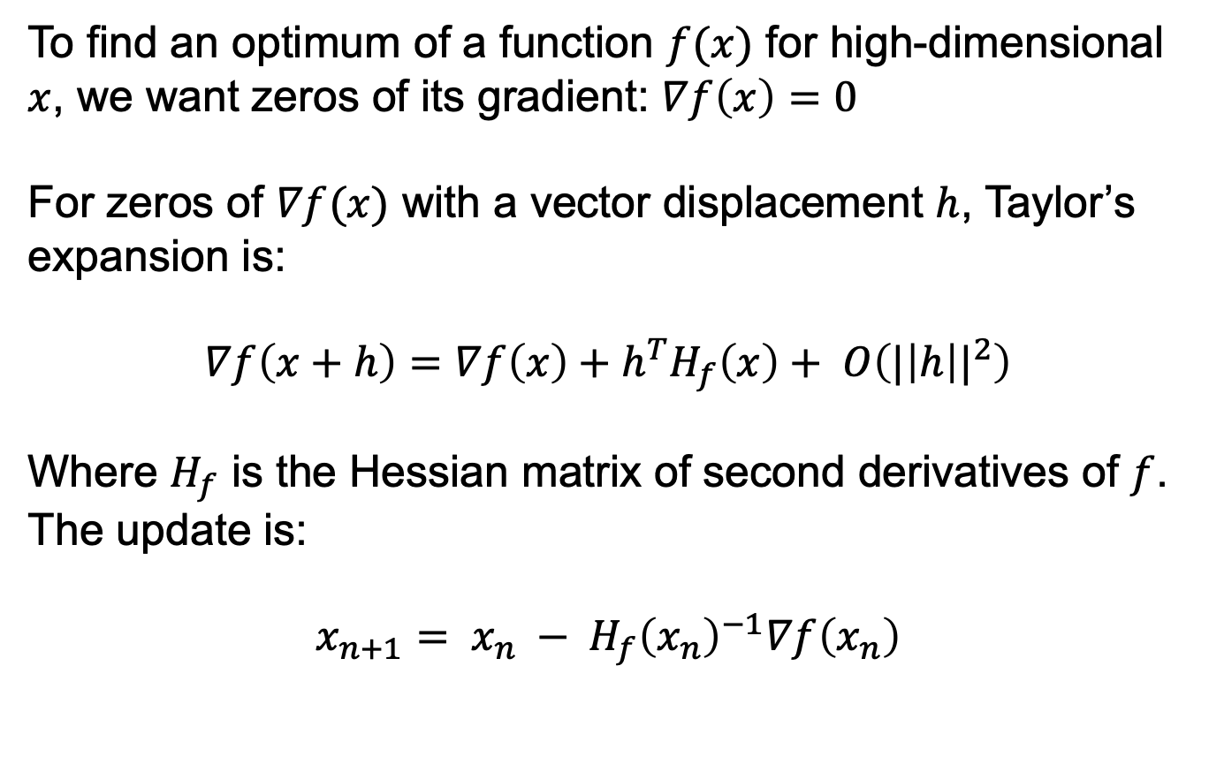
Newton’s method for gradients:
To find an optimum of a function $f(x)$ for high-dimensional $x$, we want zeros of its gradient: $∇f\left(x\right)=0$
For zeros of $∇f(x)$ with a vector displacement $h$, Taylor’s expansion is:
$$∇f\left(x+h\right)=∇f\left(x\right)+h^{T}H_{f}\left(x\right)+ O\left({|\left|h\right||}^{2}\right)$$
Where $H_{f}$ is the Hessian matrix of second derivatives of $f$. The update is:
$$x_{n+1}= x_{n} − {H_{f}\left(x_{n}\right)}^{−1}∇f\left(x_{n}\right)$$
Slide based on CS294-129 by John Canny

Slide 45
Newton step
W_2
Standard gradient
Newton gradient step
W_1
Slide based on CS294-129 by John Canny

Slide 46
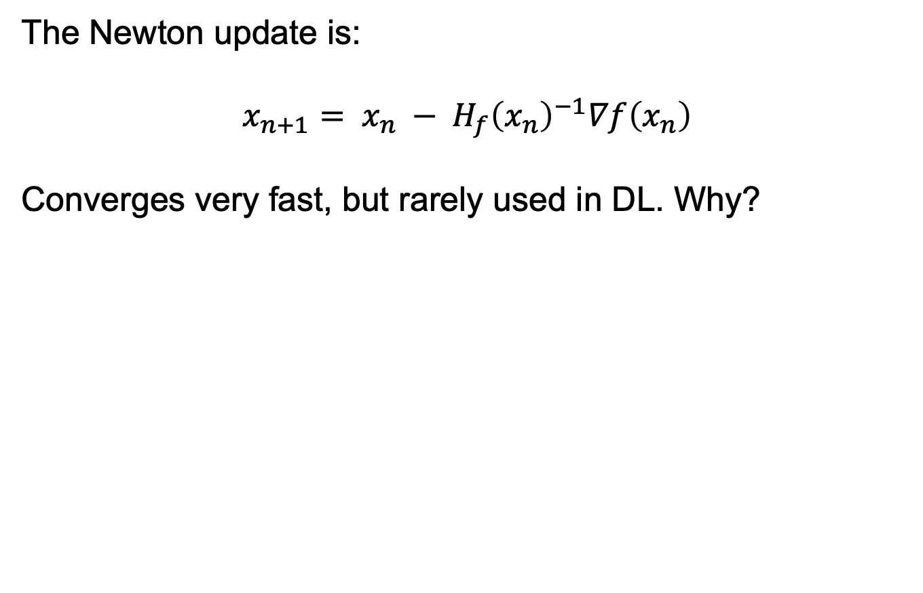
Newton’s method for gradients:
The Newton update is:
$$x_{n+1}= x_{n} − {H_{f}\left(x_{n}\right)}^{−1}∇f\left(x_{n}\right)$$
Converges very fast, but rarely used in DL. Why?
Slide based on CS294-129 by John Canny

Slide 47
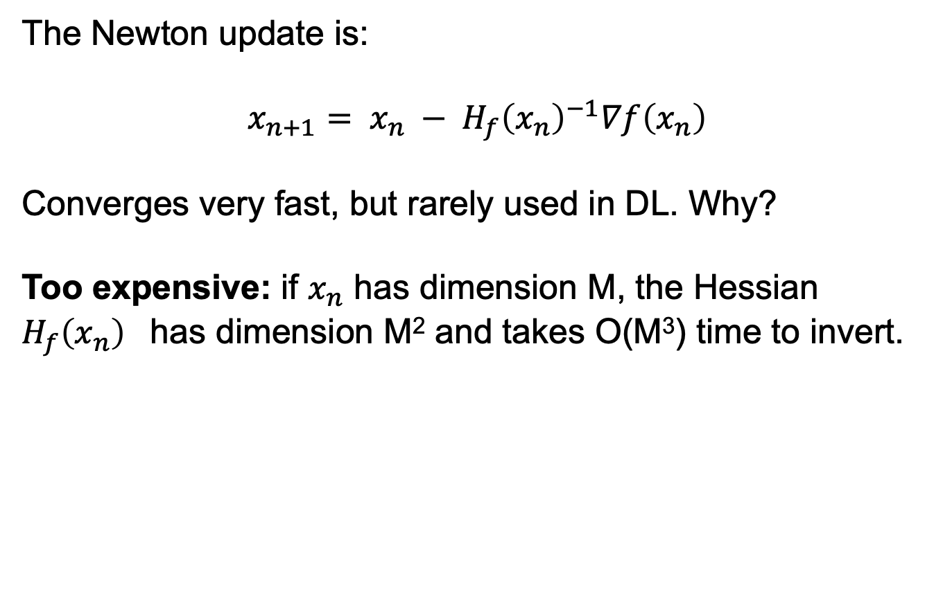
Newton’s method for gradients:
The Newton update is:
$$x_{n+1}= x_{n} − {H_{f}\left(x_{n}\right)}^{−1}∇f\left(x_{n}\right)$$
Converges very fast, but rarely used in DL. Why?
Too expensive: if $x_{n}$ has dimension M, the Hessian ${H_{f}\left(x_{n}\right)}^{}$has dimension M² and takes O(M³) time to invert.
Slide based on CS294-129 by John Canny

Slide 48
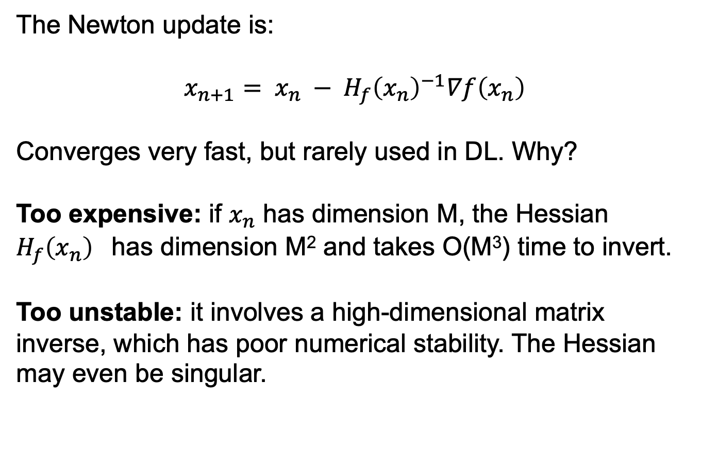
Newton’s method for gradients:
The Newton update is:
$$x_{n+1}= x_{n} − {H_{f}\left(x_{n}\right)}^{−1}∇f\left(x_{n}\right)$$
Converges very fast, but rarely used in DL. Why?
Too expensive: if $x_{n}$ has dimension M, the Hessian ${H_{f}\left(x_{n}\right)}^{}$has dimension M² and takes O(M³) time to invert.
Too unstable: it involves a high-dimensional matrix inverse, which has poor numerical stability. The Hessian may even be singular.
Slide based on CS294-129 by John Canny

Slide 49
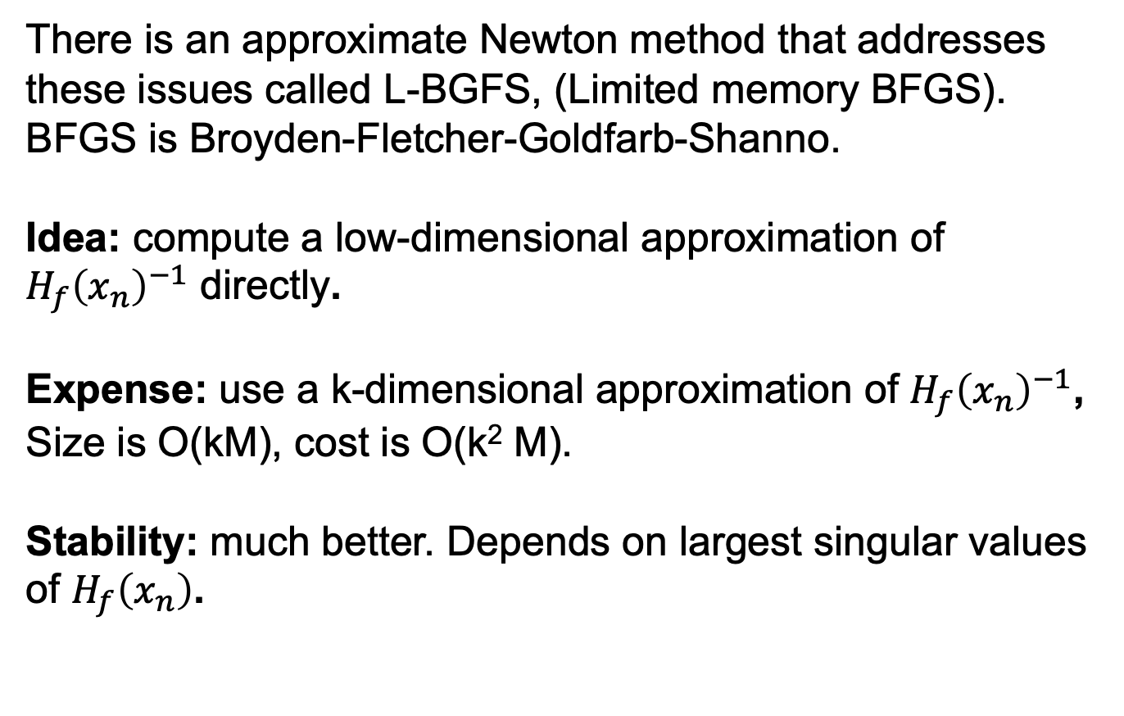
L-BFGS
There is an approximate Newton method that addresses these issues called L-BGFS, (Limited memory BFGS).
BFGS is Broyden-Fletcher-Goldfarb-Shanno.
Idea: compute a low-dimensional approximation of ${H_{f}\left(x_{n}\right)}^{−1}$ directly.
Expense: use a k-dimensional approximation of ${H_{f}\left(x_{n}\right)}^{−1}$,
Size is O(kM), cost is O(k² M).
Stability: much better. Depends on largest singular values of $H_{f}\left(x_{n}\right)$.
Slide based on CS294-129 by John Canny

Slide 50
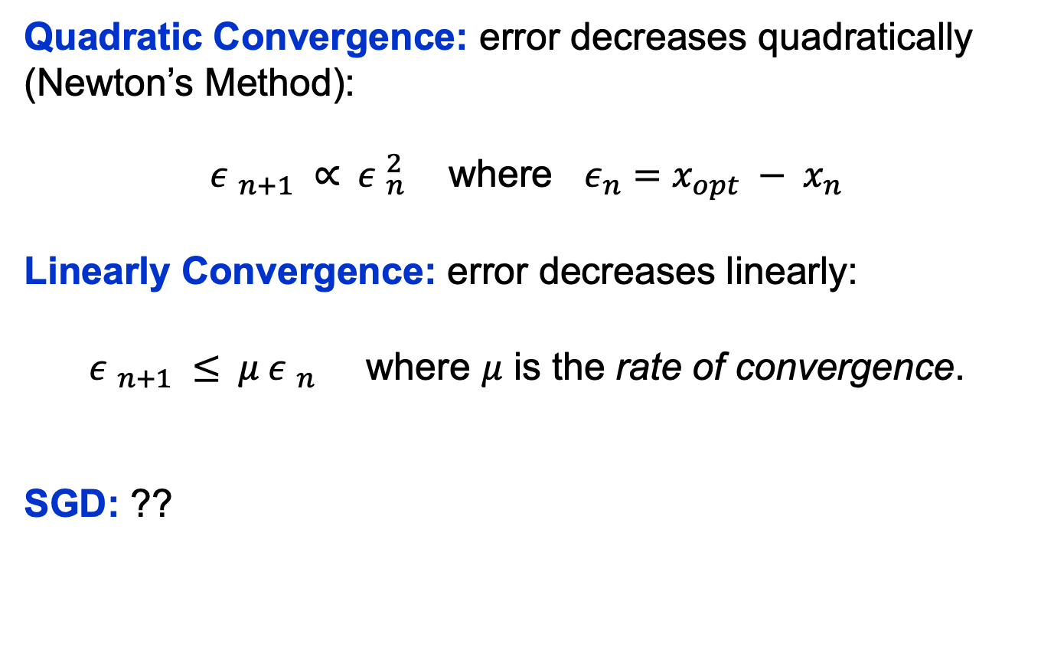
Convergence Nomenclature
Quadratic Convergence: error decreases quadratically (Newton’s Method):
${ε }_{n+1} ∝{ ε }_{n}^{2}$ where $ε_{n}=x_{opt} − x_{n}$
Linearly Convergence: error decreases linearly:
${ε }_{n+1} ≤{ μ ε }_{n}^{}$ where $μ$ is the rate of convergence.
SGD: ??
Slide based on CS294-129 by John Canny

Slide 51
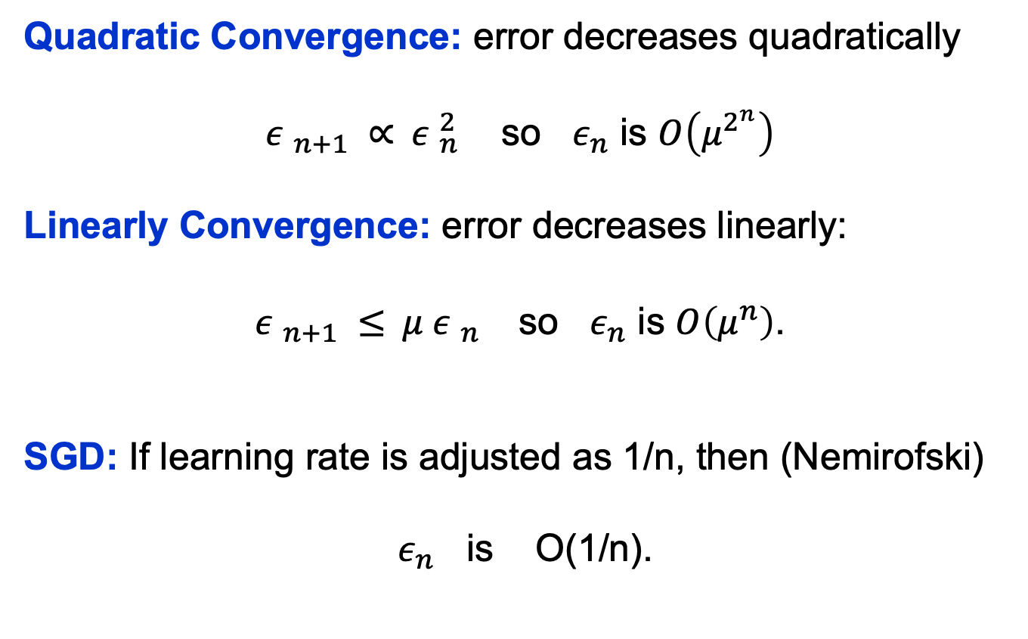
Convergence Behavior
Quadratic Convergence: error decreases quadratically
${ε }_{n+1} ∝{ ε }_{n}^{2}$ so $ε_{n}$ is $O\left(μ^{2^{n}}\right)$
Linearly Convergence: error decreases linearly:
${ε }_{n+1} ≤{ μ ε }_{n}^{}$ so $ε_{n}$ is $O\left(μ^{n}\right)$.
SGD: If learning rate is adjusted as 1/n, then (Nemirofski)
$ε_{n}$ is O(1/n).
Slide based on CS294-129 by John Canny

Slide 52
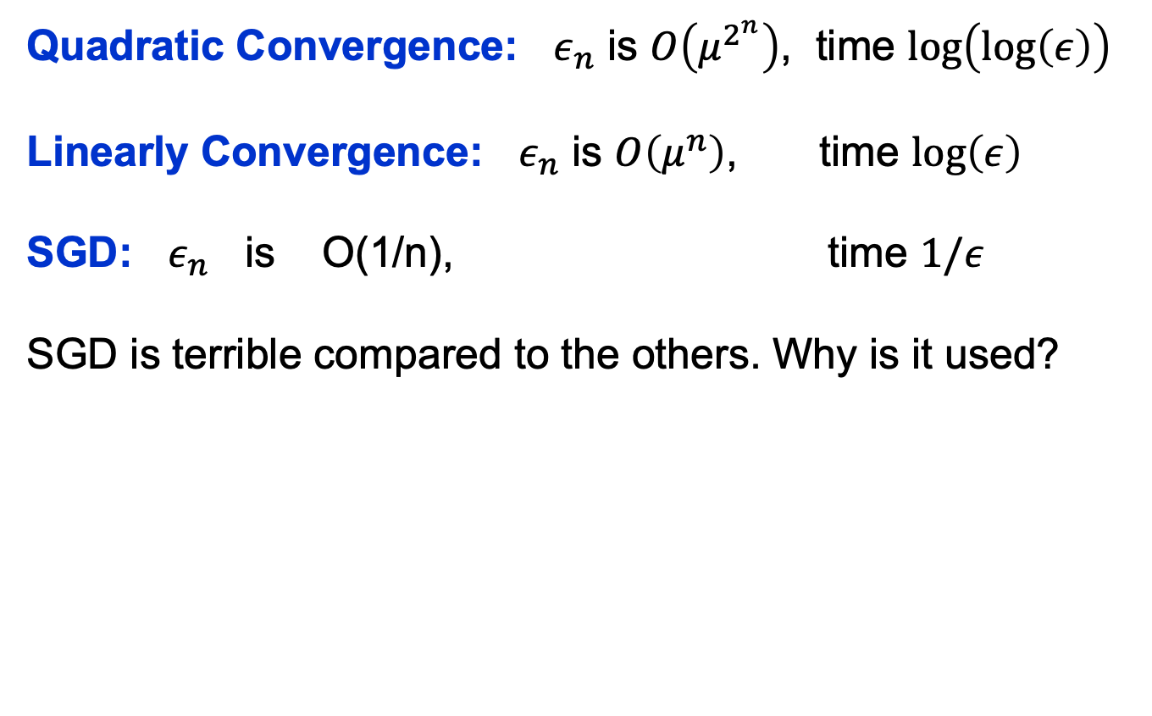
Convergence Comparison
Quadratic Convergence: $ε_{n}$ is $O\left(μ^{2^{n}}\right)$, time $\text{log}\left(log⁡\left(ε\right)\right)$
Linearly Convergence: $ε_{n}$ is $O\left(μ^{n}\right)$, time $\text{log}\left(ε\right)$
SGD: $ε_{n}$ is O(1/n), time $1/ε$
SGD is terrible compared to the others. Why is it used?
Slide based on CS294-129 by John Canny

Slide 53
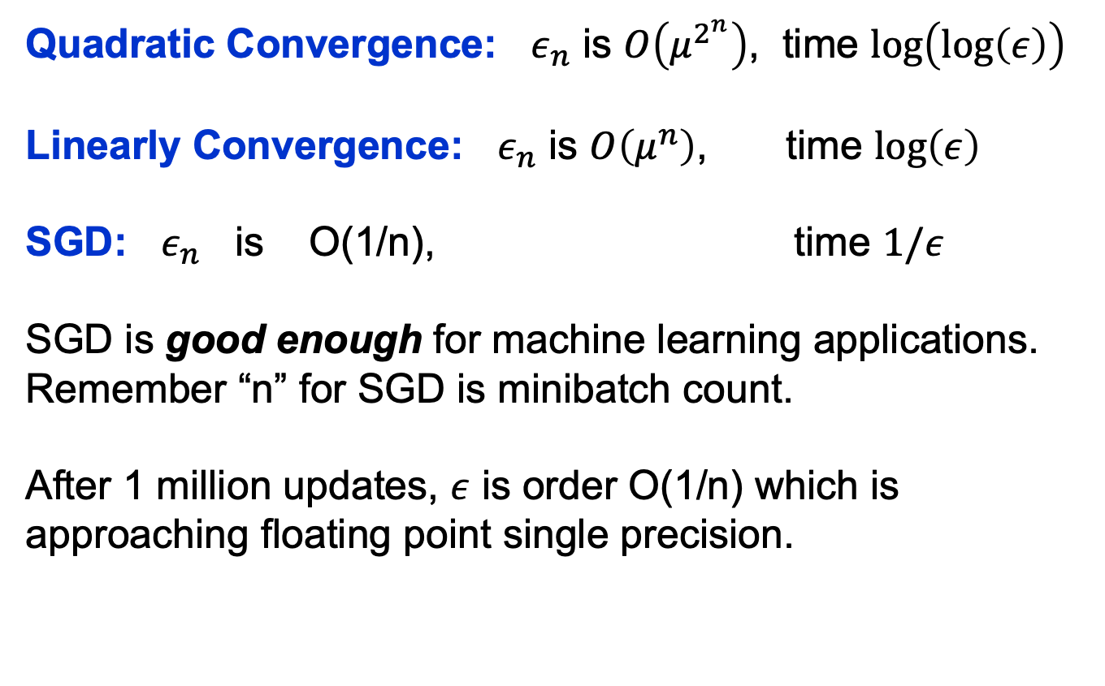
Convergence Comparison
Quadratic Convergence: $ε_{n}$ is $O\left(μ^{2^{n}}\right)$, time $\text{log}\left(log⁡\left(ε\right)\right)$
Linearly Convergence: $ε_{n}$ is $O\left(μ^{n}\right)$, time $\text{log}\left(ε\right)$
SGD: $ε_{n}$ is O(1/n), time $1/ε$
SGD is good enough for machine learning applications.
Remember “n” for SGD is minibatch count.
After 1 million updates, $ε$ is order O(1/n) which is approaching floating point single precision.
Slide based on CS294-129 by John Canny

Slide 54
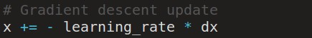
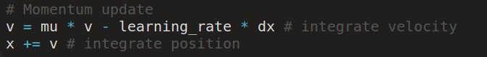
Momentum update
- Physical interpretation as ball rolling down the loss function + friction (mu coefficient).
- mu = usually ~0.5, 0.9, or 0.99 (Sometimes annealed over time, e.g. from 0.5 -> 0.99)

Slide 55
Momentum update
Allows a velocity to “build up” along shallow directions
Velocity becomes damped in steep direction due to quickly changing sign

Slide 56
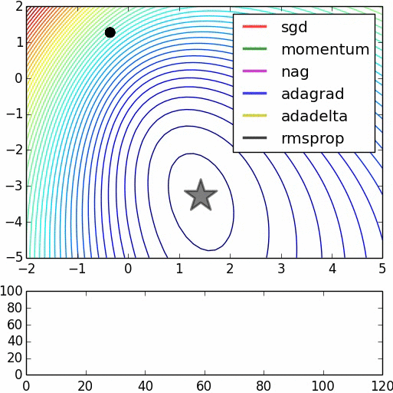
SGD
vs
Momentum
notice momentum
overshooting the target, but overall getting to the minimum much faster than vanilla SGD.

Slide 57
Nesterov Momentum update
Ordinary momentum update:
momentum
step
actual step
gradient
step

Slide 58
Nesterov Momentum update
Momentum update
Nesterov momentum update
“lookahead” gradient step (bit different than original)
momentum
step
momentum
step
actual step
actual step
gradient
step

Slide 59
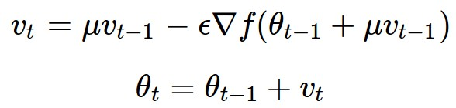
Nesterov Momentum update
Momentum update
Nesterov momentum update
“lookahead” gradient step (bit different than original)
momentum
step
momentum
step
actual step
actual step
gradient
step
Nesterov: the only difference...

Slide 60
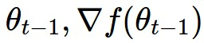
Nesterov Momentum update
Slightly inconvenient…
usually we have :

Slide 61
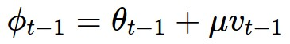
Nesterov Momentum update
Slightly inconvenient…
usually we have :
Variable transform and rearranging saves the day:

Slide 62
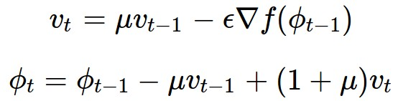
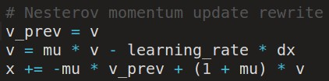
Nesterov Momentum update
Slightly inconvenient…
usually we have :
Variable transform and rearranging saves the day:
Replace all thetas with phis, rearrange and obtain:

Slide 63
nag =
Nesterov Accelerated Gradient

Slide 64
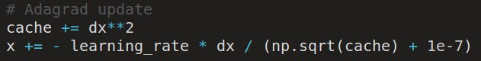
AdaGrad update
[Duchi et al., 2011]
Added element-wise scaling of the gradient based on the historical sum of squares in each dimension

Slide 65
AdaGrad update
Q: What happens with AdaGrad?

Slide 66
AdaGrad update
Q2: What happens to the step size over long time?

Slide 67
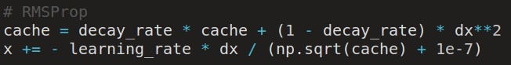
RMSProp update
[Tieleman and Hinton, 2012]

Slide 68
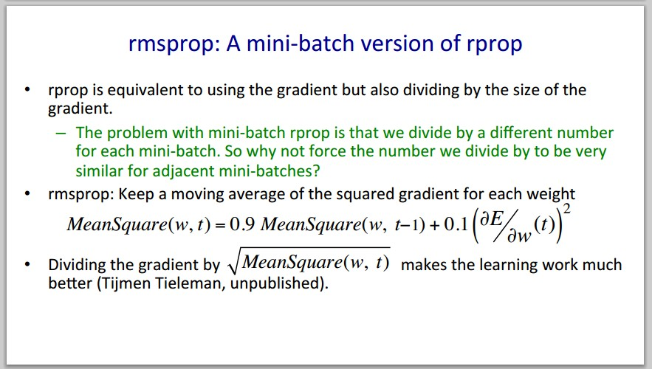
Introduced in a slide in Geoff Hinton’s Coursera class, lecture 6

Slide 69
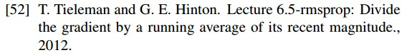
Introduced in a slide in Geoff Hinton’s Coursera class, lecture 6
Cited by several papers as:

Slide 70
adagrad
rmsprop

Slide 71
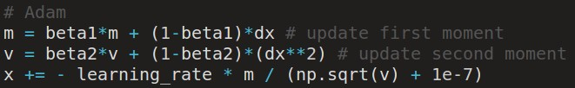
Adam update
[Kingma and Ba, 2014]
(incomplete, but close)

Slide 72
Adam update
[Kingma and Ba, 2014]
(incomplete, but close)
momentum
RMSProp-like
Looks a bit like RMSProp with momentum

Slide 73
Adam update
[Kingma and Ba, 2014]
(incomplete, but close)
momentum
RMSProp-like
Looks a bit like RMSProp with momentum

Slide 74
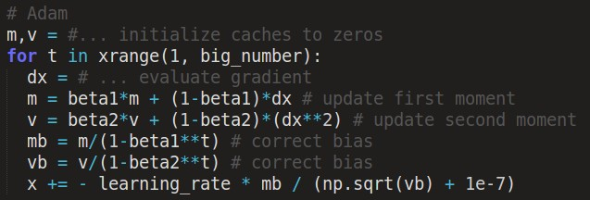
Adam update
[Kingma and Ba, 2014]
momentum
bias correction
(only relevant in first few iterations when t is small)
RMSProp-like
The bias correction compensates for the fact that m,v are initialized at zero and need some time to “warm up”.

Slide 75
SGD, SGD+Momentum, Adagrad, RMSProp, Adam all have learning rate as a hyperparameter.
Q: Which one of these learning rates is best to use?

Slide 76
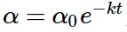
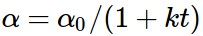
SGD, SGD+Momentum, Adagrad, RMSProp, Adam all have learning rate as a hyperparameter.
=> Learning rate decay over time!
step decay:
e.g. decay learning rate by half every few epochs.
exponential decay:
1/t decay:

Slide 77
Summary
Simple Gradient Methods like SGD can make adequate progress to an optimum when used on minibatches of data.
Second-order methods make much better progress toward the goal, but are more expensive and unstable.
Convergence rates: quadratic, linear, O(1/n).
Momentum: is another method to produce better effective gradients.
ADAGRAD, RMSprop diagonally scale the gradient. ADAM scales and applies momentum.

Slide 78

The effects of different update formulas
(image credits to Alec Radford)

Slide 79
Questions?

